Slide 1
Reading sign language
Data Augmentation using DCNN

Slide 2
Motivation
Data Augmentation allows to recognize objects and human faces
Today there is no mobile APP available to translate in real time
Realisation seems possible

Slide 3
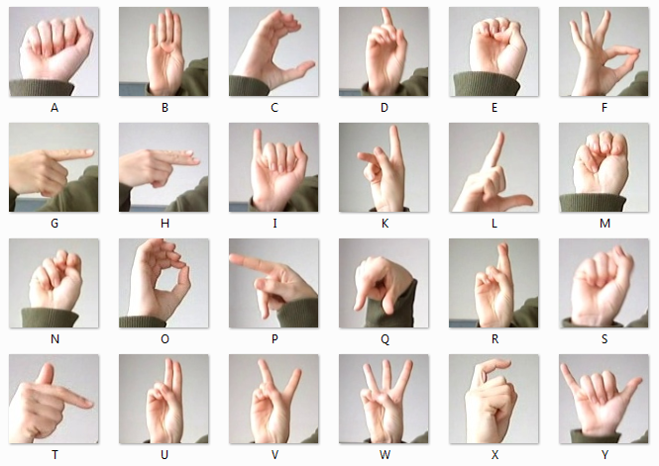
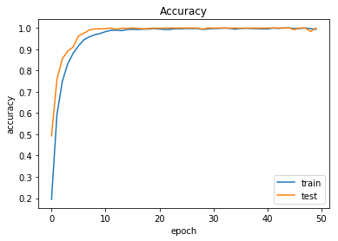
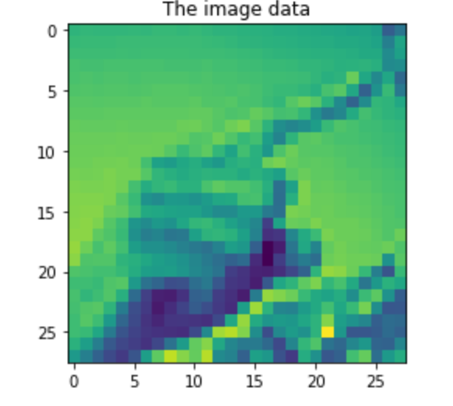
The First Attempt
Grayscaled & resized to arrays
► Acc. ≈ 88%

Slide 4
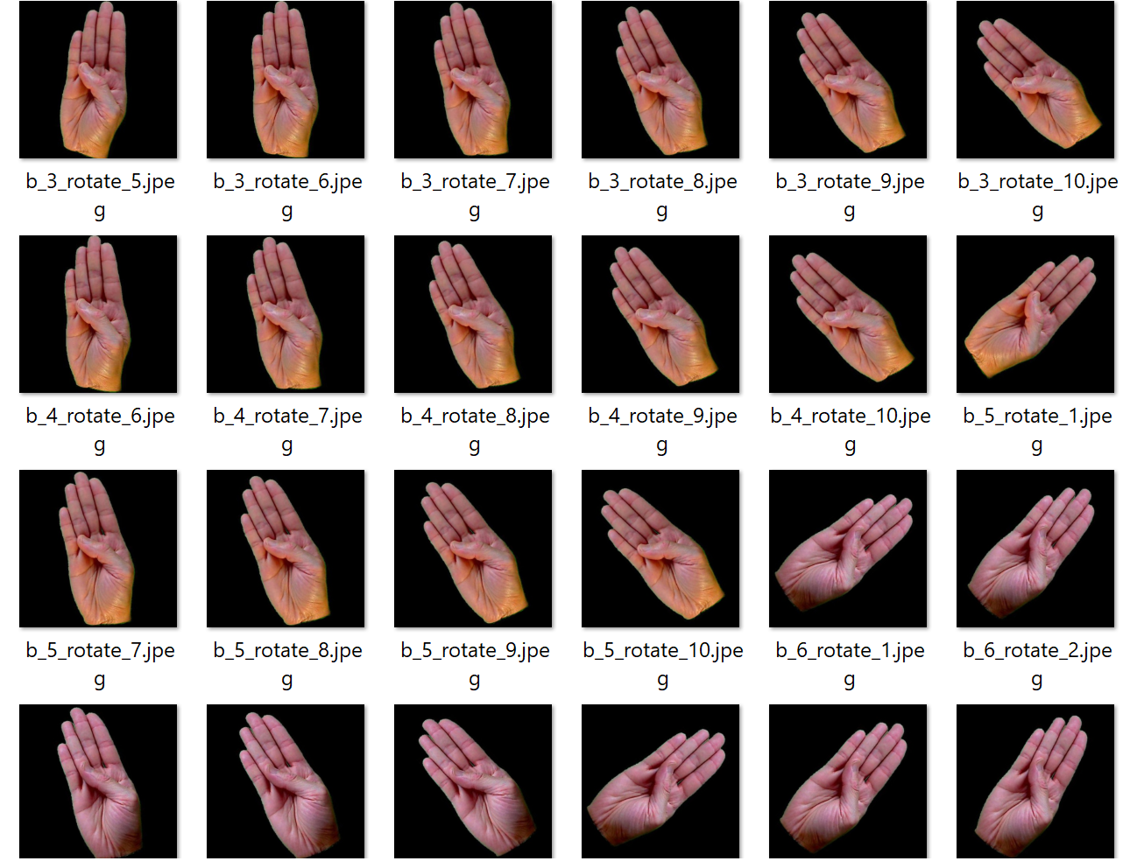
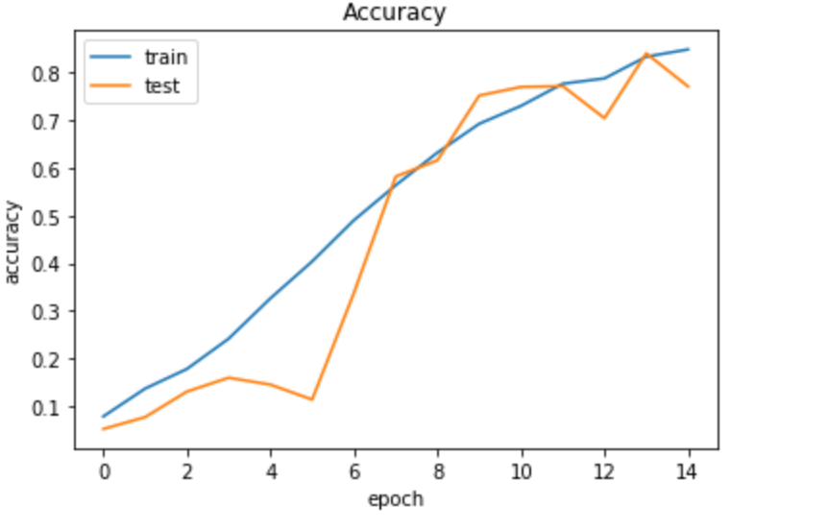
The Second Attempt
Modification and Merge datasets
► Acc. ≈ 56 %

Slide 5
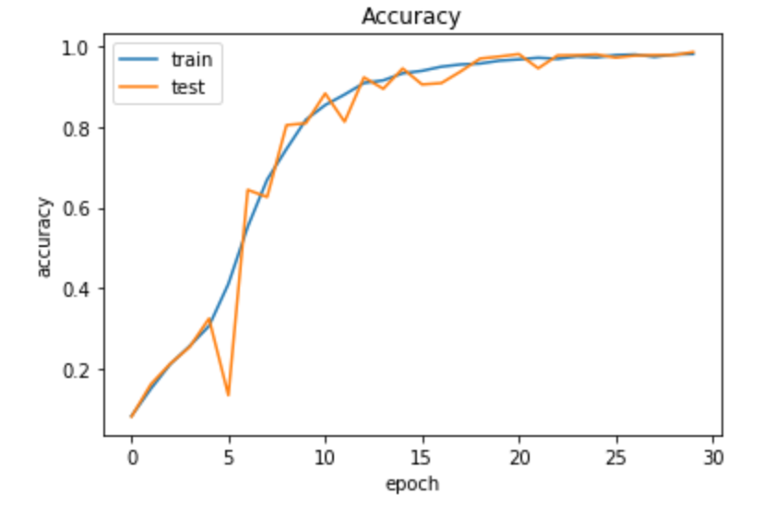
The Third Attempt
Changes:
Again more layers, higher kernels
Decreased pool sizes
Balanced data split
► Acc. ≈ 89 %

Slide 6
Demo of the Model

Slide 7
Problems at the current stage
Dataset
Model
Low quality of the additional dataset
Small pictures of the original dataset
Pictures with low variety
Unoptimized Hyperparameters and Layers f.e. Pool-Size still too high

Slide 8
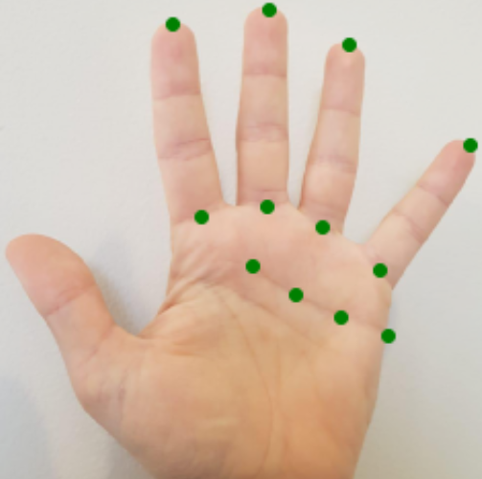
Further steps
In the current model
Advancing the model
Generate more and diversified datasets
Community
Optimize the current model
Start with “Hand Keypoint Detection“

Slide 9
Attachments

Slide 10
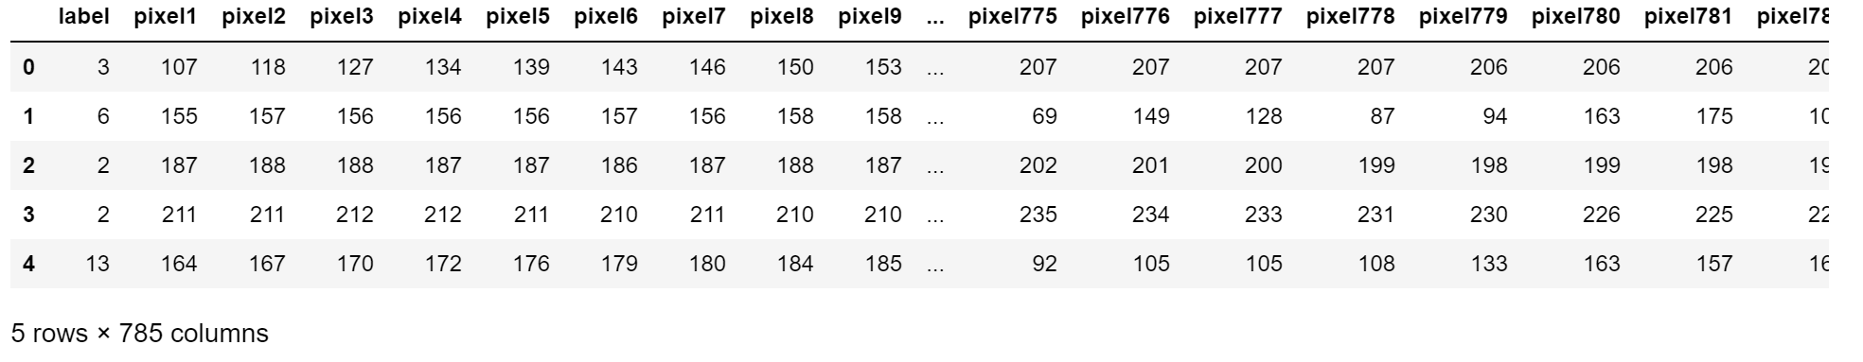
Original dataset (1/2)
A part of the MNIST*
More than 27k pictures (training dataset)
Additional 7k pictures for testing
Letter „J“ and „Z“ aren´t included
Already grayscaled and transformed to arrays
*Modified National Institute of Standards and Technology database

Slide 11
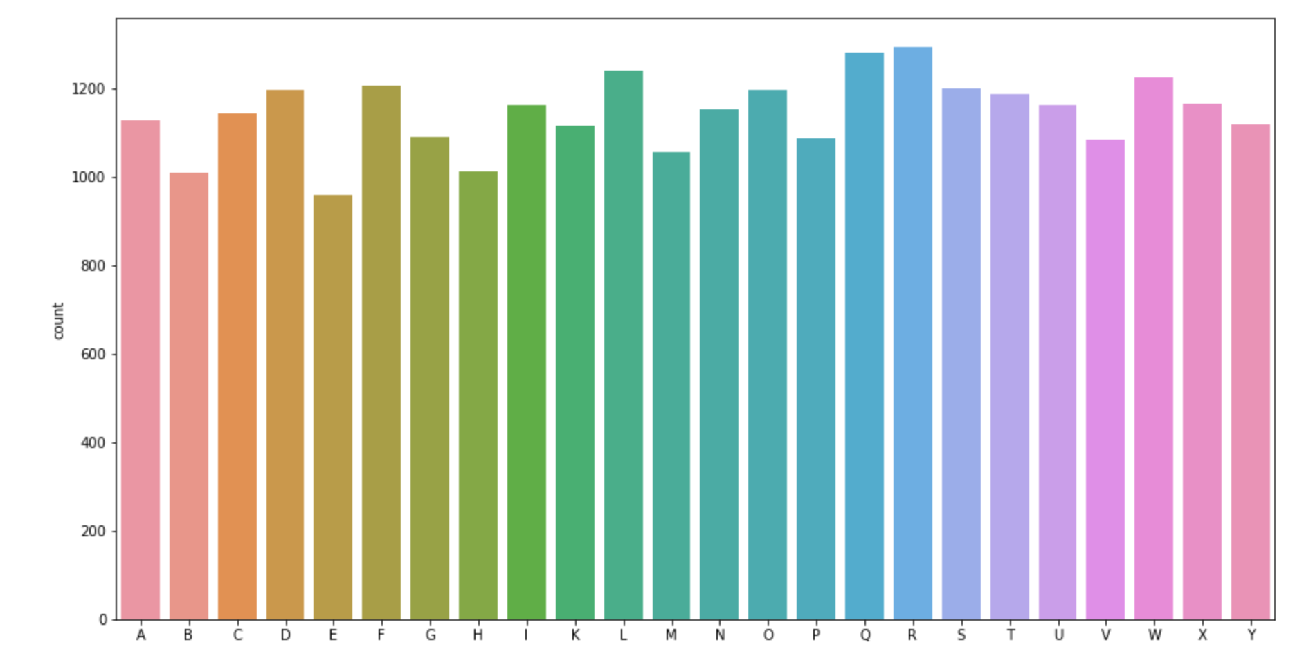
Original dataset (2/2)

Slide 12
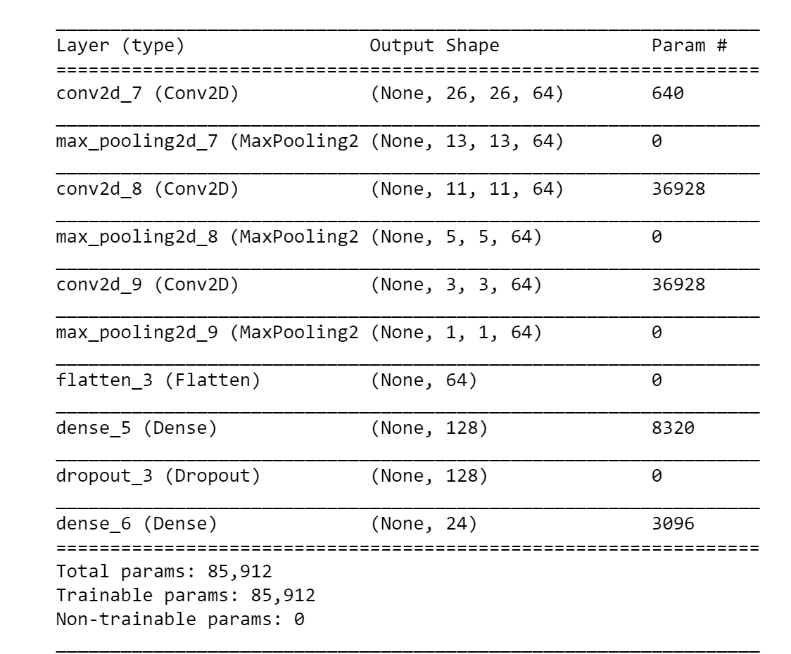
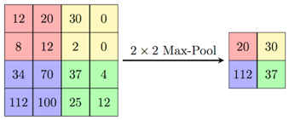
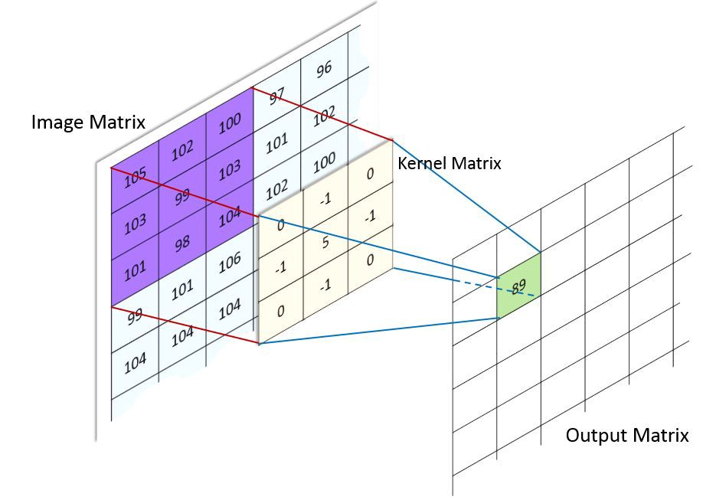
The first Model
Epochs = 20, Batch-Size = 128, test-size 0.3

Slide 13
New Dataset
19k of pictures (after excl. of digits and J“ and „Z“)
Preparation to match the old dataset:
Transforme to arrays
Grayscale
Resize
After merge 46k pictures

Slide 14
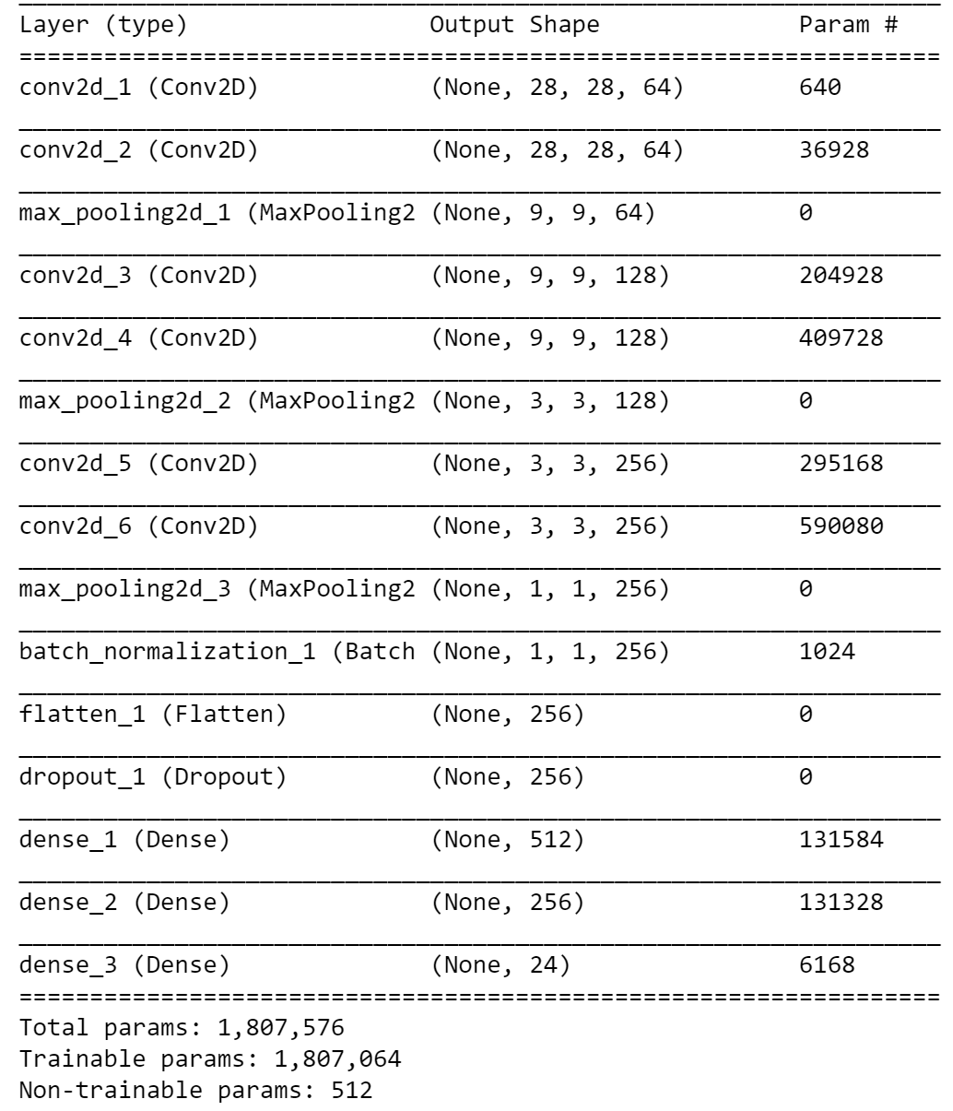
The second Model
Changes:
Doubled number of convolutional layers, with higher kernels
Increased pool-sizes of MaxPool
Additonal Dens-Layer
Epochs = 15, Batch-Size = 256, test-size = 0.3

Slide 15
The Second Attempt
Additional Dataset
Kaggle Community
> 19k actual pictures
> 46k frame data (after merge)
For the merge the pictures had to be transformed:
Resized
Grayscaled
Normalized
Smoothing
etc.
Model
Changes: More layers, higher kernels
Hyperparameter:
Epochs = 15
Batch-Size = 256
Test-Size = 0.3
► Acc. ≈ 56%

Slide 16
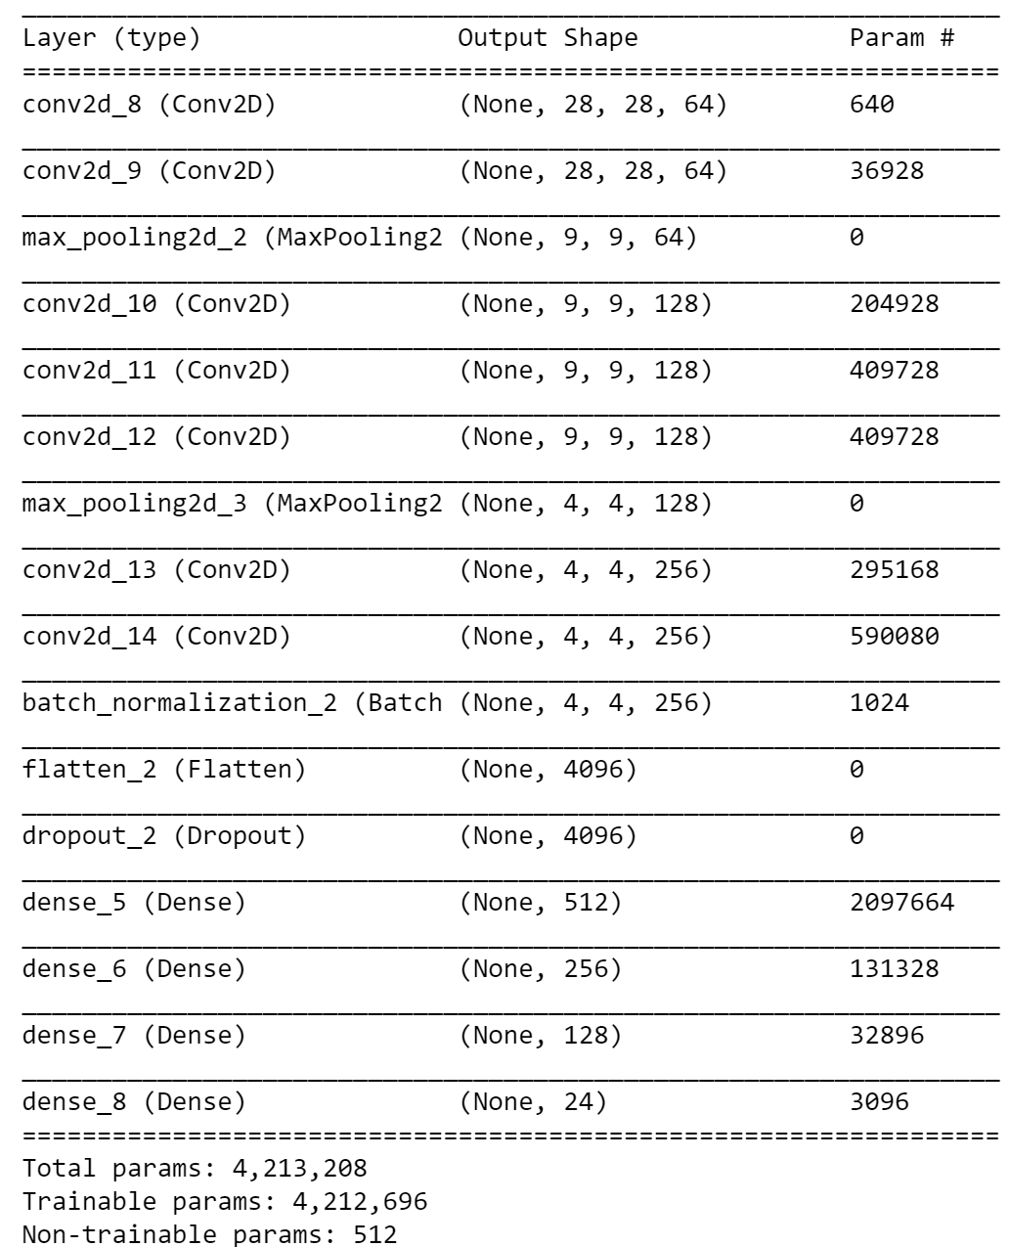
The third Model
Changes:
More convolutional layers, with again higher kernels
Decreased pool-sizes of MaxPool
Most importnant:
Balanced the data split (into train and test)
Epochs = 30, Batch-Size = 128, test-size = 0.3

Slide 17
The Third Attempt
Model
Changes:
Again more layers, higher kernels
Decreased pool sizes
Balanced data split
Hyperparameter:
Epochs = 30
Batch-Size = 128
Test-Size = 0.3
► Acc. ≈ 89%

